Slide 1
“rosenrenewed.com” Web Project: Concept & Analysis
By Darlene Rosa

Slide 2
Client of the Website: Young Adult, Artist/Creative, Author, Model, Photographer
Intended Users of the Website
Target audience:
90% women, 10% men
Income Level:
$40,000 – $125,000
Age:
21 – 55
Internet Connectivity: WiFi, SmartPhone

Slide 3
Visit Scenarios: #1: Customer is transferred to page after clicking on a sponsored post/ad or through the link on Instagram. They want to view more photos or read more on the blog. #2: Customer finds page through SEO by searching for relationship blog, Latina/millennial writers, best non-fiction and/or poetry book, or inspirational feminine style photography.
Website Goals:
To sell merchandise
To increase brand awareness and engagement through gallery and blogs
Acquire new subscribers

Slide 4
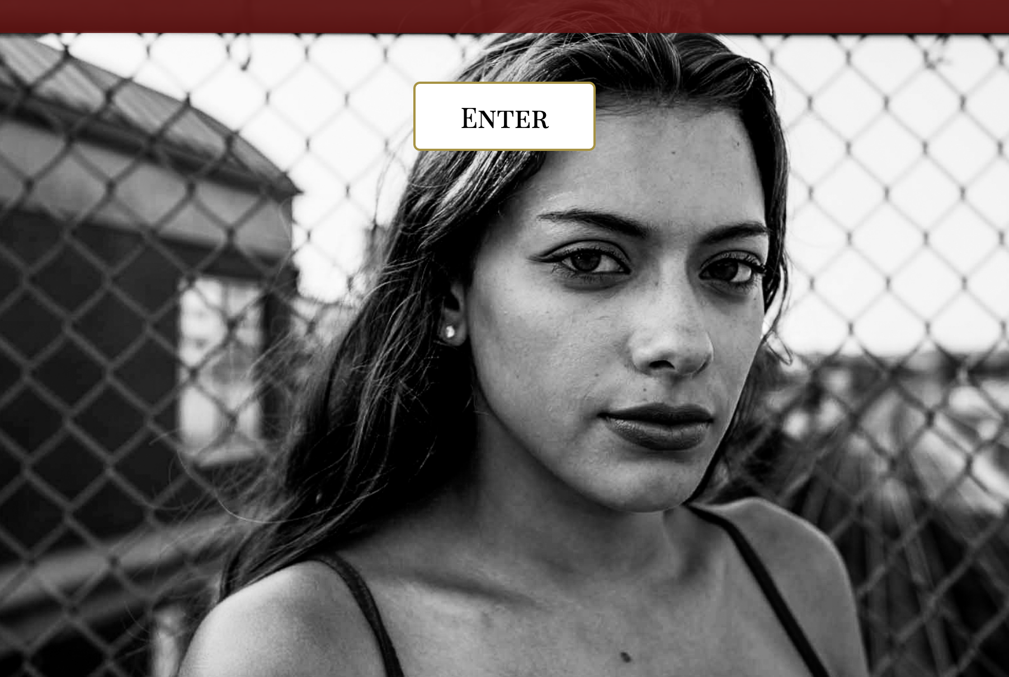
Index page

Slide 5
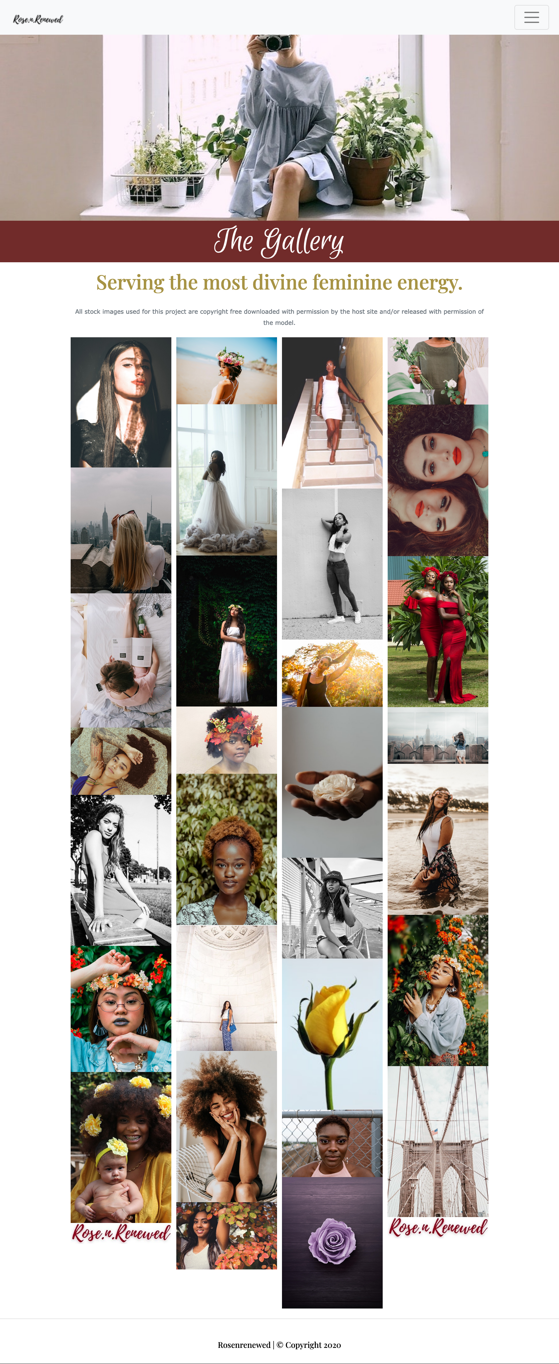
Photo Gallery Page

Slide 6
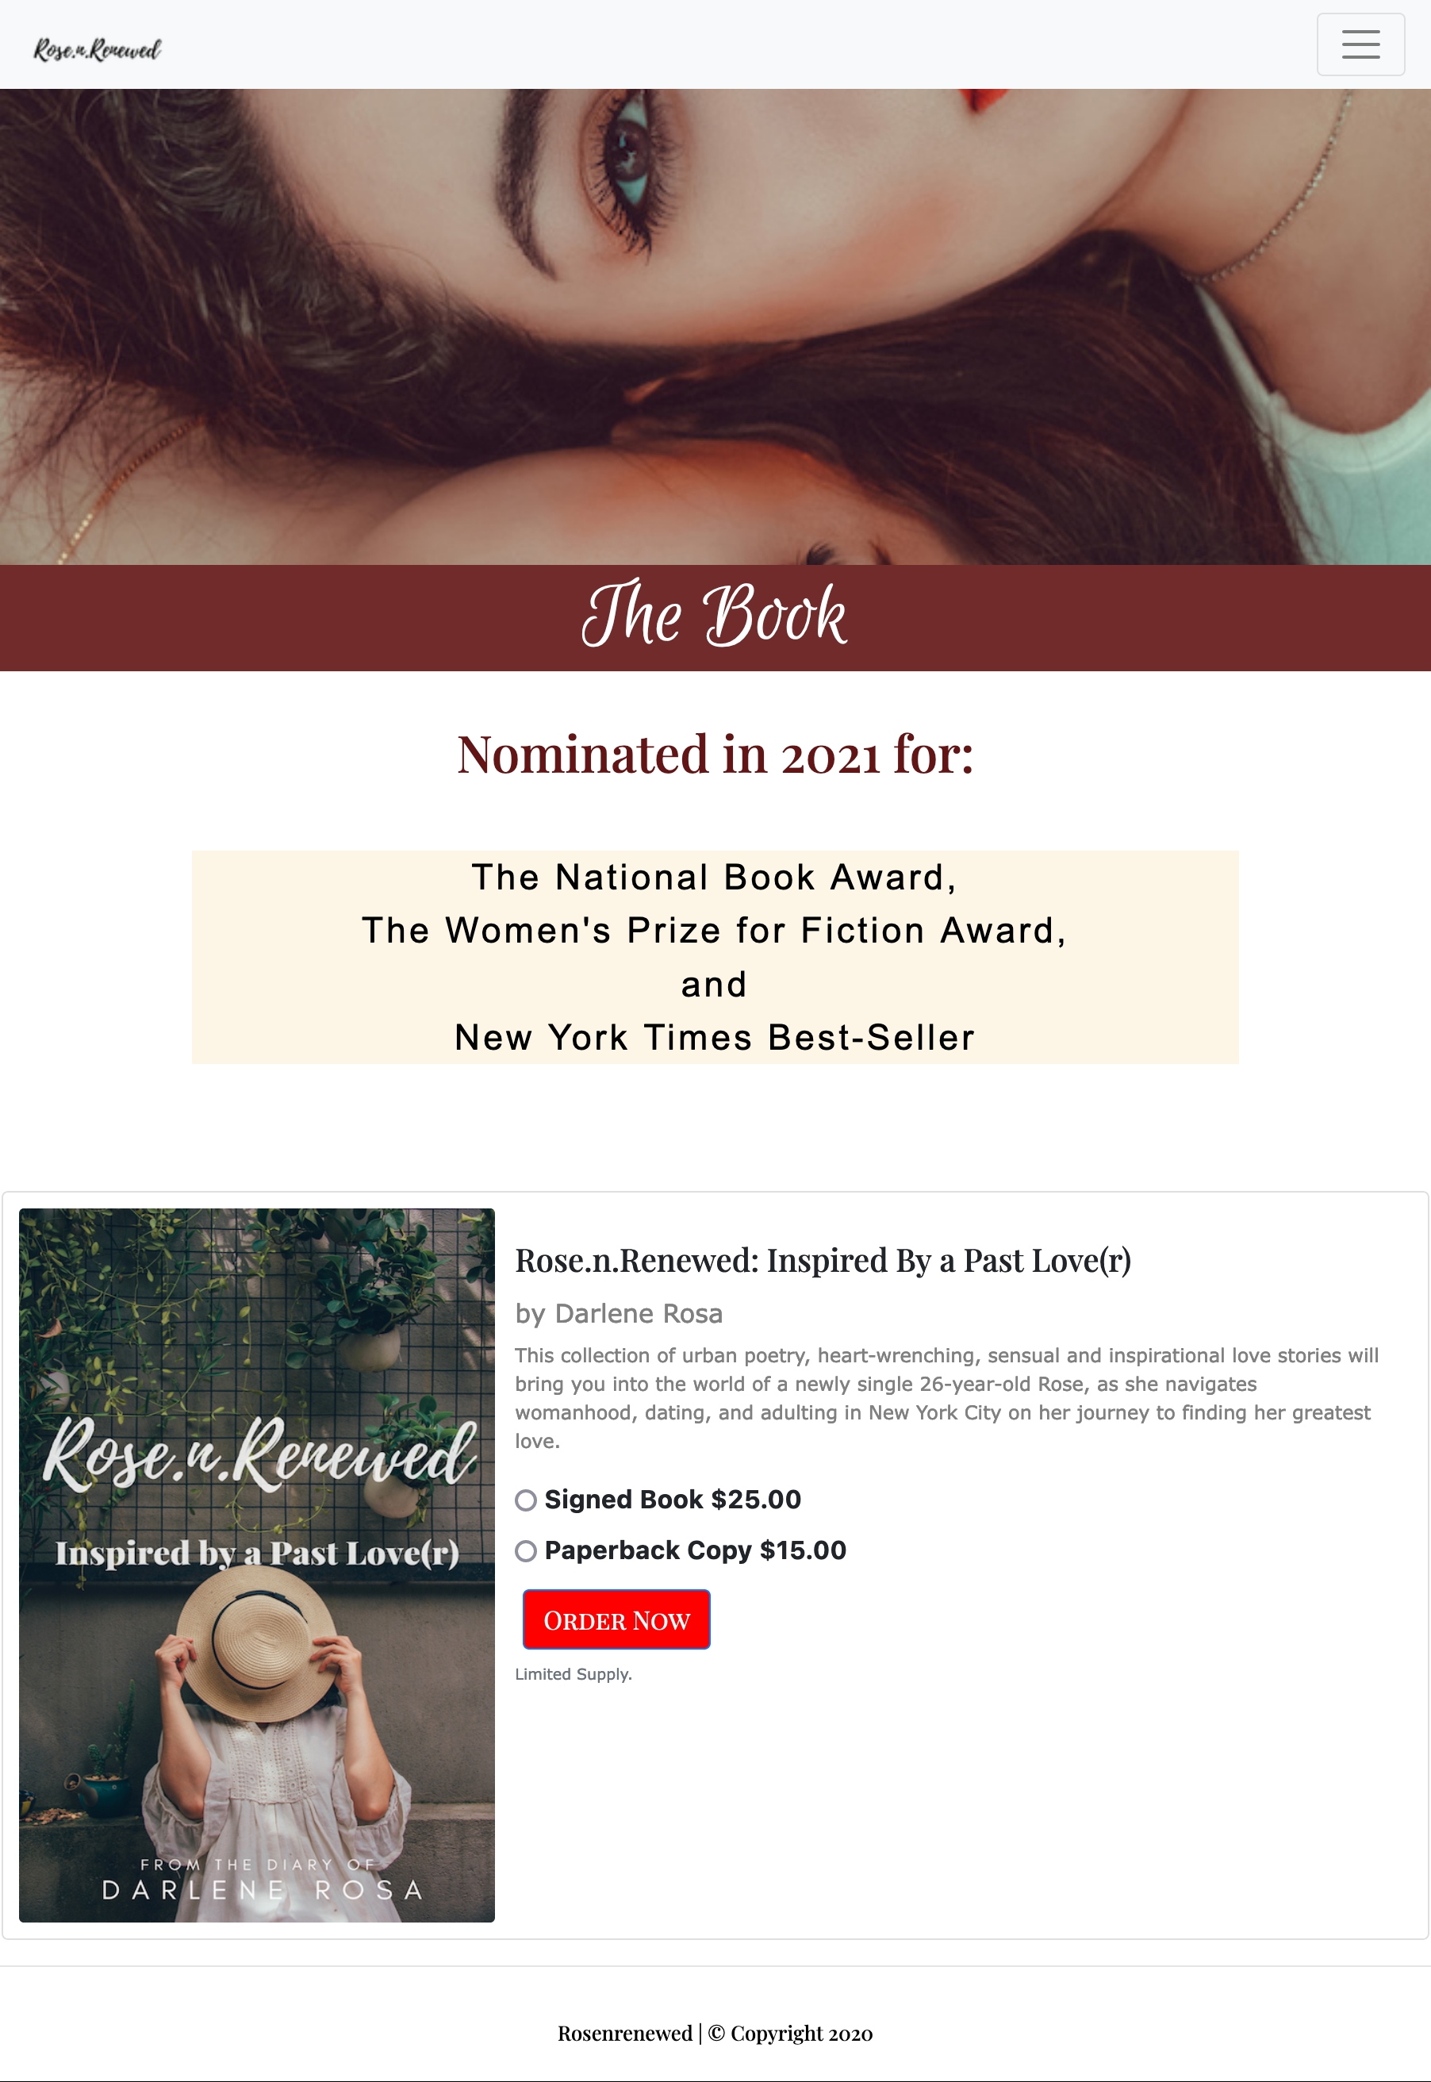
Shop Page

Slide 7
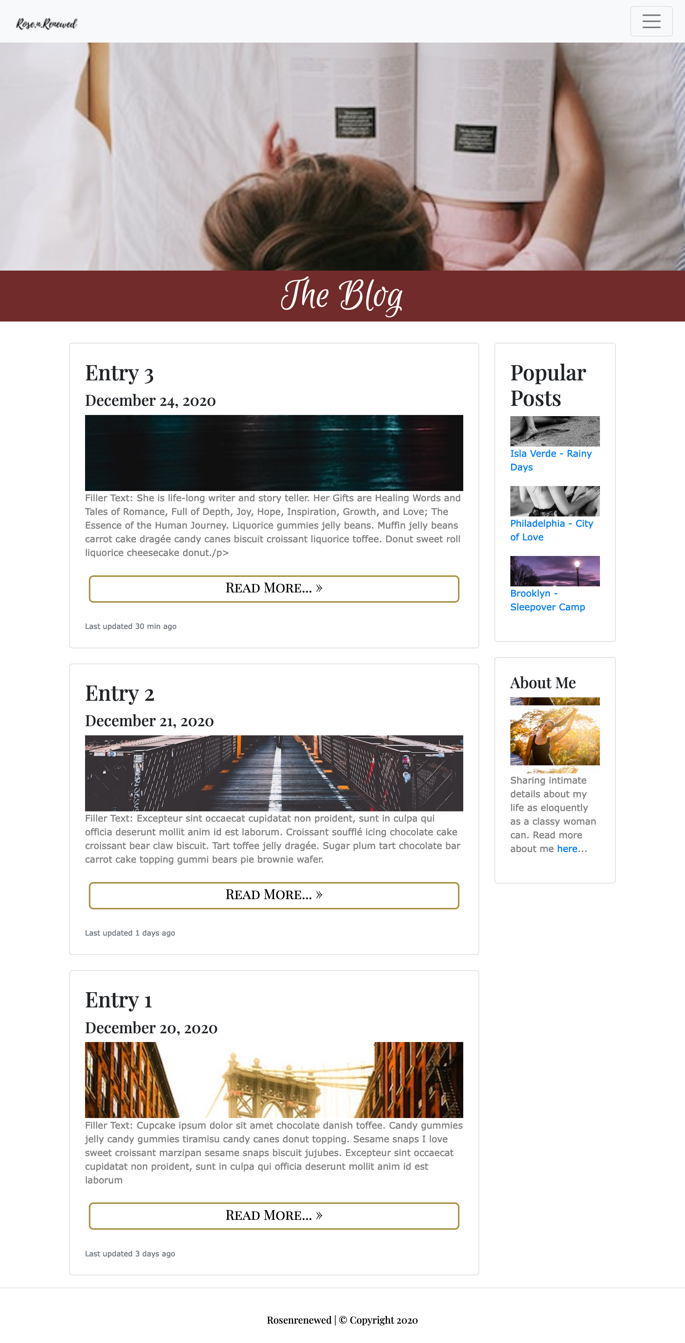
Blog Page

Slide 8
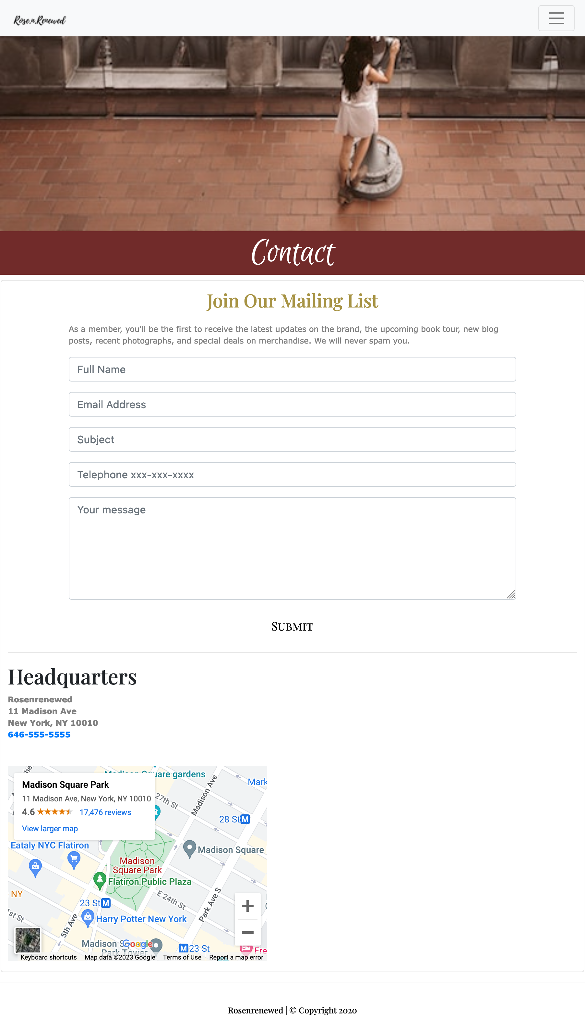
Contact Page

Slide 9
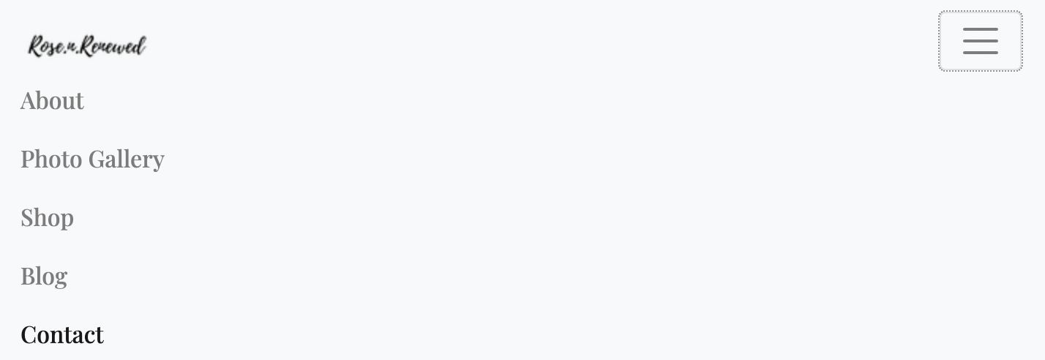
Responsive Nav Bar

